Slide 1
Managerial Planning, Goal Setting and Change Management
0

Slide 2
Learning Objectives
0
Define goals and plans and explain the relationship between them.
Explain the concept of organizational mission and how it influences goal setting and planning.
Describe the types of goals an organization should have and why they resemble a hierarchy.
Define the characteristics of effective goals.

Slide 3
Learning Objectives (contd.)
0
Describe the four essential steps in the MBO process.
Explain the difference between single-use plans and standing plans.
Describe and explain the importance of the three stages of crisis management planning.
Summarize the guidelines for high-performance planning in a fast-changing environment.

Slide 4
Planning for the Future
0
Most organizations are facing turbulence and growing uncertainty
  Economic, political, & social turmoil = managers wonder how to cope
  Renewed interest in organizational planning

Slide 5
Goals and Plans
0
Goal - A desired future state that the organization attempts to realize
Plan - A blueprint specifying the resource allocations, schedules, and other actions necessary for attaining goals
Planning – determining the organization’s goals and the means for achieving them
  the most fundamental management function
  the most controversial management function

Slide 6
Levels of Goals/Plans & Their Importance
0
External Message Legitimacy for investors, customers, suppliers, community
Mission Statement
Strategic Goals/Plans Senior Management (Organization as a whole)
Internal Message Legitimacy, motivation, guides, rationale, standards
Tactical Goals/Plans Middle Management (Major divisions, functions)
Operational Goals/Plans Lower Management (Departments, individuals)

Slide 7
Benefits for the Organization
0
Provided from Internal and External Messages Goals and Plans Send
Legitimacy
  What the organization stands for - reason for being
  Symbolizes legitimacy
  Employees identify with overall purpose
Source of Motivation and Commitment
  Employees’ identification with the organization
  Motivate by reducing uncertainty
Resource allocation
  Allocate employees, money, and equipment
Guides to Action
  Provide a sense of direction; focus attention on specific targets
  Direct efforts toward important outcomes

Slide 8
Benefits for the Organization
0
Provided from Internal and External Messages Goals and Plans Send
Rationale for Decisions
  Learn what organization is trying to accomplish
  Make decisions to ensure that internal policies, roles, performance, structure, products, and expenditures will be made in accordance with desired outcomes
Standard of Performance (MBO)
  Serve as performance criteria
  Provide a standard of assessment

Slide 9
Organizational Mission
0
Mission - organization’s reason for existing
Mission Statement
  Broadly states the basic business scope and operations that distinguishes it from similar types of organizations
  May include the market and customers
  Some may describe company values, product quality, attitudes toward employees

Slide 10

Ben & Jerry’s Mission Statement:
0
Ben & Jerry’s is founded on and dedicated to a sustainable corporate concept of linked prosperity. Our mission consists of 3 interrelated parts:
Social Mission: To operate the Company in a way that actively recognizes the central role that business plays in society by initiating innovative ways to improve the quality of life locally, nationally and internationally.
Product Mission: To make, distribute and sell the finest quality all natural ice cream and euphoric concoctions with a continued commitment to incorporating wholesome, natural ingredients and promoting business practices that respect the Earth and the Environment.
Economic Mission: To operate the Company on a sustainable financial basis of profitable growth, increasing value for our stakeholders and expanding opportunities for development and career growth for our employees.
Underlying the mission of Ben & Jerry’s is the determination to seek new and creative ways of addressing all three parts, while holding a deep respect for individuals inside and outside the company and for the communities of which they are a part.

Slide 11
Strategic Goals and Plans
0
Strategic Goals
Where the organization wants to be in the future
Pertain to the organization as a whole
Strategic Plans
Action Steps used to attain strategic goals
Blueprint that defines the organizational activities and resource allocations
Tends to be long term 1-5 years

Slide 12
Tactical or Functional
Goals and Plans
0
Tactical/Functional Goals
Apply to middle management
Goals that define the outcomes that major divisions and departments must achieve
Tactical/Functional Plans
Plans designed to help execute major strategic
plans
Shorter time frame than strategic plans 3months-1 year

Slide 13
Operational Goals and Plans
0
Operational Goals
Specific, measurable results
Expected from departments, work groups, and individuals
Operational Plans
Organization’s lower levels that specify action steps toward achieving operational goals
Tool for daily and weekly operations
Schedules are an important component

Slide 14
Goal Alignment
0
Means-end Chain
Achievement of goals at lower levels permits the attainment of high-level goals
Traditional organizational responsibility
  Strategic = top management
  Tactical/Functional – middle management
  Operational = 1st line management & workers

Slide 15
Characteristics of Effective
Goal Setting
0
Specific and measurable
Covers key result areas
Challenging but realistic
Defined time period
Linked to rewards

Slide 16
SMART Goals
Specific
Measurable
Attainable
Rewards
Time
Does this declaration meet the criteria?
“Our goal for the project is to raise awareness.”

Slide 17
Management by Objective
Model of the MBO Process
0
Step 1: Set Goals
Step 2: Develop Action Plans
Corporate Strategic Goals Departmental goals Individual goals
Action Plans
Review Progress
Step 3:
Review Progress
Take Corrective Action
Appraise Performance
Step 4: Appraise Overall Performance

Slide 18
MBO Benefits and Problems
0
Benefits of MBO
Problems with MBO
Manager and employee efforts are focused on activities that will lead to goal attainment
Performance can be improved at all company levels
Employees are motivated
Departmental and individual goals are aligned with company goals
Constant change prevents MBO from taking hold
An environment of poor employer-employee relations reduces MBO effectiveness
Strategic goals may be displaced by operational goals
Mechanistic organizations and values that discourage participation can harm the MBO process
Too much paperwork saps MBO energy

Slide 19
Single-Use Plans
For Goals Not Likely To Be Repeated
0
A program is a complex set of objectives and plans to achieve an important, one-time organizational goal
A project is similar to a program, but generally smaller in scope and complexity
Notes:
17

Slide 20
Standing Plans
For Tasks Performed Repeatedly
0
A policy is a general guide to action and provides direction for people within the organization
Rules describe how a specific action is to be performed
Procedures define a precise series of steps to be used in achieving a specific job
Notes:
18

Slide 21
Contingency Plans
Specific Situations - unexpected conditions
0
Identify Uncontrollable Factors
  Economic turndowns
  Declining markets
  Increases in costs of supplies
  Technological developments
  Safety accidents
  Weather complications
Minimize Impact of Uncontrollable Factors
  Forecast a range of alternative responses to most-likely high-impact contingencies

Slide 22
Building Scenarios
0
Looking at trends and discontinuities and imagining possible alternative futures to build a framework within which unexpected future events can be managed
Forces managers to rehearse mentally what they would do if their best-laid plans were to collapse

Slide 23
Crisis Management Planning
Sudden - Devastating –Require Immediate Response
0
Prevention
  Build trusting relationship with key stakeholders
  Open communication
Preparation
  Crisis Management Team
  Crisis Management Plan
  Establish an Effective Communications system
Containment

Slide 24
Planning for Performance
0
Central Planning = Traditional Department or Group of planning specialists who develop plans for the organization as a whole and its major divisions and departments and typically report directly to the president or CEO
Decentralized Planning = High-Performance Managers work with their people to develop their own goals and plans

Slide 25
Planning In The New Workplace
0
Have a strong mission statement and vision
Set stretch goals for excellence
Establish a culture that encourages learning
Embrace event-driven planning
Utilize temporary task forces
Planning still starts and stops at the top
Planning comes alive when employees are involved in setting goals and determining the means to reach them

Slide 26
Change
0
Today’s organizations need to continuously adapt to new situations if they are to survive and prosper
One of the most dramatic elements is the shift to a technology- driven workplace
Ideas, information, and relationships are becoming critically important

Slide 27
Organizational Change
0
The adoption of a new idea of behavior by an organization
A product change is a change in the organization’s product or service outputs.
A technology change is a change in the organization’s production process – how the organization does its work.

Slide 28
Idea Champion
0
Change does not occur by itself
A person who sees the need for and
champions productive change within
the organization

Slide 29
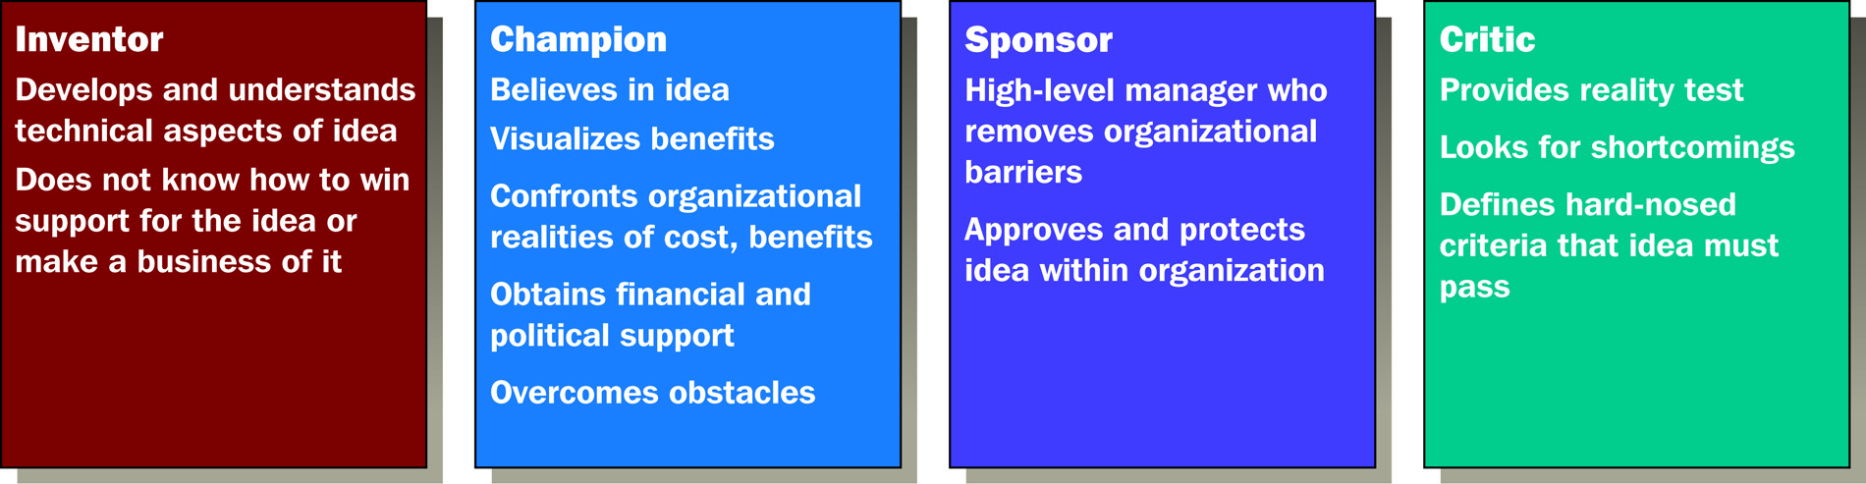
Four Roles in Organizational Change
0

Slide 30
New Venture Teams
0
New Venture Team = Unit separate from the mainstream of the organization that is responsible for developing and initiating innovations
Skunkworks = separate small, informal, highly autonomous, and often secretive group that focuses on breakthrough ideas for the business

Slide 31
New Venture Fund
0
Fund providing resources from which individuals and groups can draw to develop new ideas, products, or businesses
Idea Incubator = in-house program that provides a safe harbor where ideas from employees throughout the organization can be developed without interference from company bureaucracy or politics

Slide 32
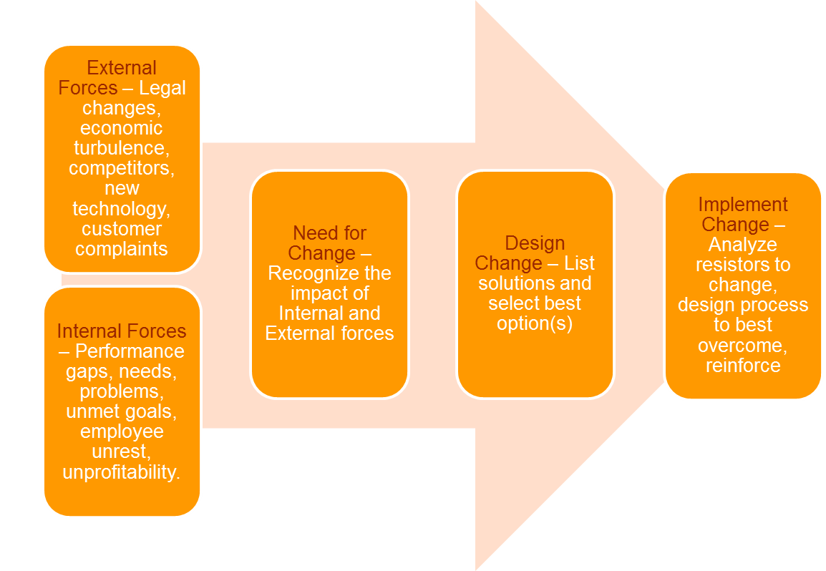
Model for Change

Slide 33
Forces for Change
0
External Forces
  Customers
  Competitors
  Technology
  Economic
  Global Changes
Internal Forces – Performance gaps, needs, problems, unmet goals, employee unrest, unprofitability

Slide 34
Need for Change
0
Based on external or internal forces
Performance gap = disparity between existing and desired performance levels.
  Current procedures are not up to standard
  New idea or technology could improve current performance
  Maybe the goal is unrealistic

Slide 35
Design Change
Clearly Define problem
Create options – Brainstorm, Benchmark, Best Practices, Focus groups
Select Best Option(s)
Create New Goals and Plans

Slide 36
Implementation by analyzing Resistance to Change
0
Self-Interest: fear of personal loss is perhaps the biggest obstacle to organizational change
Lack of Understanding and Trust: do not understand the intended purpose of a change or distrust the intentions
Uncertainty: lack of information about future events
Different Assessments and Goals: people who will be affected by innovation may assess the situation differently

Slide 37
Preferred Tactics for Overcoming
Resistance to Change
0
Approach
When to Use
Communication
Education
Participation
Top management support
Change is technical; users need accurate information & analysis
Users need to feel involved; design requires information from others; have power to resist
Involves multiple departments or reallocation of resources; users doubt legitimacy of change

Slide 38
Tactics for Overcoming
Resistance to Change (only when necessary)
0
Approach
When to use
Negotiation
Coercion
A Group has power over implementation; will lose out in the change
Crisis exists; initiators clearly have power; other techniques have failed

